Slide 1

US labor statistics analysis
Sasikumar Damodaran
University of Nebraska, Omaha
Notes:
https://uslaborstatisticsdashboardsasi-d7gmw7qxupihjmcfywjsj2.streamlit.app/

Slide 2
Research Questions
Labor Force Dynamics
Wage growth Vs CPI
Cyclical Patterns
Trends
Unemployment VS Wage Growth

Slide 3
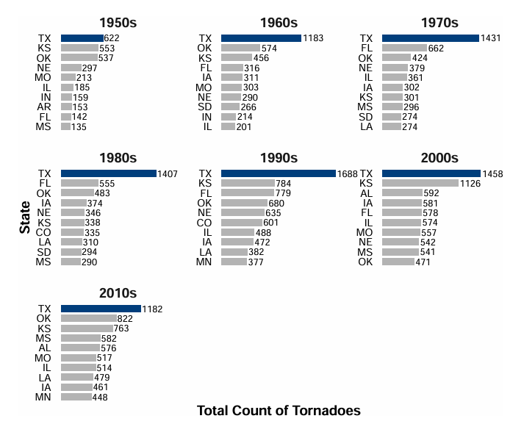
Research Questions
Motivation
Understanding US labor market dynamics is central to informed economic policymaking and personal financial planning. Traditionally, access to labor data required navigating disparate government databases. This project consolidates six complementary series into a single, democratically accessible dashboard, enabling rapid visual exploration and quantitative analysis of employment, compensation, and Consumer price Index trends.
The choice to automate data collection reflects real-world constraints: labor statistics are released monthly on fixed schedules, and manual downloading introduces human error and stalls iteration. GitHub Actions provides a free, reproducible mechanism to synchronize data automatically.
Magnitude
Changes
Fatalities
&
Injuries
Seasonality

Slide 4
Research Questions
Data Series and Coverage
113-year historical backfill (January 1913 – May 2026)
Total Nonfarm Payrolls measure overall employment levels and serve as a core indicator of labor demand. Data is available from 1913 to 2026.
Unemployment Rate tracks labor market slack across all demographic groups and is available from 1948 to 2026.
Civilian Labor Force Level captures workforce participation and helps identify discouraged worker effects; data span 1948 to 2026.
Average Weekly Hours (Total Private) reflect labor utilization along the intensive margin, available from 2006 onward.
Average Hourly Earnings (Total Private) measure nominal wage growth and are also available from 2006 onward.
Consumer Price Index (CPI-U) enables inflation adjustment and real wage analysis, with data from 1948 to 2026.
Consumer Price Index - All items index (not seasonally adjusted) -area: U.S. city average
Magnitude
Changes
Fatalities
&
Injuries
Seasonality

Slide 5
Research Questions
Limitations
Data Release Delays
BLS publishes employment data with a ~1-month lag (e.g., May data released in early June).
The dashboard always reflects the most recent published data, not real-time conditions. .
Seasonal Adjustment & Aggregation
Most employment series are seasonally adjusted (SA). The original unadjusted data contain sharp regularities (e.g., retail hiring in November–December) that the Census Bureau removes via X-13 filters.
CPI is not seasonally adjusted; the spike each January reflects seasonal energy/food costs.
Technical Constraints
BLS API limits to 20-year windows per request; this is handled but adds complexity.
Multiple series large-scale batch queries require API key registration.
Magnitude
Changes
Fatalities
&
Injuries
Seasonality

Slide 6
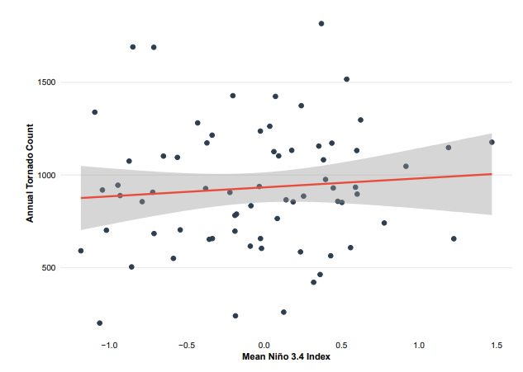
Economic Insights Gained
Trends
&
Predictability
Business-cycle co-movement Labor market indicators move systematically over the business cycle: expansions feature rising payroll employment and labor force participation alongside falling unemployment, while contractions reverse these patterns.
Real wage pressure from inflation Nominal wage growth does not necessarily translate into improved worker welfare. Periods when inflation outpaces wage growth—most notably during 2021–2025—result in real wage erosion and reduced purchasing power.
Unemployment–wage relationship A modest but persistent Phillips-curve relationship is observed, with higher unemployment associated with slower wage growth. Short-run estimates suggest that a one-percentage-point increase in unemployment corresponds to roughly a 0.18 percentage-point decline in annualized wage growth.
Employment vs. adjustment margins Payroll employment and unemployment exhibit strong inverse dynamics, while measures such as average weekly hours display weaker contemporaneous correlations, indicating that firms often adjust labor input through hours before altering employment levels.
Labor force dynamics and participation The labor force expands steadily during economic growth but may contract during downturns as discouraged workers exit, potentially understating labor-market slack when relying solely on the unemployment rate.
CONCLUSION:
ARIMA Forecast of Annual U.S. Torado Counts

